Slide 1
Operating Systems (2015R Regulation)
UNIT – 3 PROCESS SYNCHRONIZATION AND DEADLOCKS
Process Synchronization: Background - The critical-section problem (Software based solution and hardware based solution) – Semaphores – Classic Problems of Synchronization – Monitors.
Deadlocks: System model - Deadlock Characterization – Methods for Handling Deadlocks -Deadlock Prevention – Deadlock Avoidance – Deadlock Detection – Recovery from Deadlocks.

Slide 2
Process synchronization : Background
Concurrent access to shared data may result in data inconsistency.
Maintaining data consistency requires mechanisms to ensure the orderly execution of co-operating processes.
Example:
Producer consumer problem (also called as bounded buffer problem)
Producer:
The producer ’s job is to generate a piece of data, put into the buffer and start again.
Consumer:
The consumer is consuming the data (removing it from the buffer) one piece at a time.
Conflict:
The problem is to make sure that the producer won’t try to add data into the buffer if it’s full and that the consumer won’t try to remove data from an empty buffer.

Slide 3
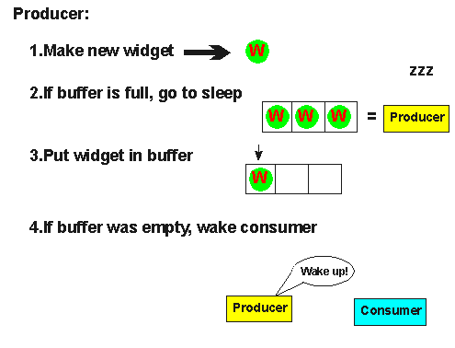
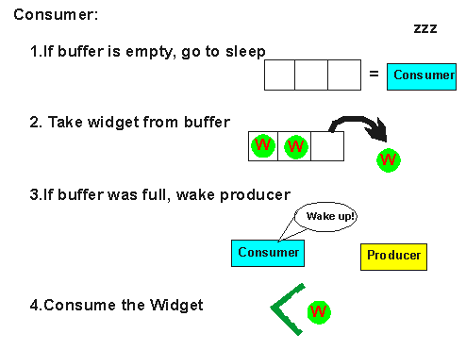
Solution:
Producer:
Producer either go to sleep or discard data if the buffer is full.
The next item the consumer removes an item from the buffer and it notifies the producer who starts to fill the buffer again.
Consumer:
Consumer can go to sleep if it finds the buffer to be empty.
The next time the producer puts data into buffer, it wakes up the sleeping consumer.
Producer: Consumer:

Slide 4
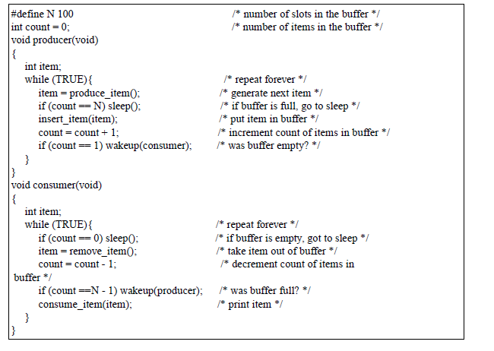
Producer and consumer problem.
Conflict:
The producer and consumer problem with above solution is that it contains a race condition that can lead into a deadlock.

Slide 5
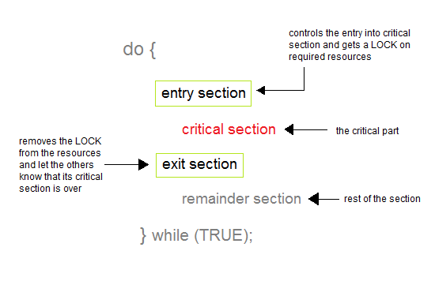
The Critical-Section Problem:
‘n’ processes all competing to use some shared data.
Each process has a code segment, called critical section , in which the shared data is accessed.
Problem − ensure that when one process is executing in its critical section, no other process is allowed to execute in its critical section.

Slide 6
A solution to the critical-section problem must satisfy the following three requirements:
1) Mutual Exclusion
Only one process at a time can be executing in their critical section..
2) Progress
If no process is executing in its critical section waiting process must be permitted to enter critical section next, and this selection cannot be postponed indefinitely.
3) Bounded Waiting
There exists a bound, or limit: There is a limit for how many times a process are can enter into critical sections. After a process has made a request to enter its critical section and before that request is granted.
[Access delayed leads to starvation leads to deadlock]
Deadlock and Starvation both are the conditions where the processes requesting for a resource has been delayed for a long. Although deadlock and starvation both are different from each other in many aspects.
Deadlock is a condition where no process proceeds for execution, and each waits for resources that have been acquired by the other processes.
On the other hands, in Starvation, process waits for an indefinite period of time to get the resource it requires.
( High priorities continuously uses the resources preventing low priority process to acquire the resources)

Slide 7
Operating Systems (2015R Regulation)
Various methods to solve critical section problem:
Software based solution
Peterson’s solution
Hardware based solution (Synchronization Hardware)
Test & Set
Swap
Semaphores
Monitors
Classic problems of synchronization
The bounded buffer problem
The Readers writers problem
The dining philosophers problem
Sleeping barber problem
Cigarette smokers problem

Slide 8
Operating Systems (2015R Regulation)
Various methods to solve critical section problem:
Software based solution
Peterson’s solution
The variable turn indicates whose turn it is to enter critical section.
A flag[] array of size N , Process need to enter critical section.
Process P0 | Process P1
While (true) { flag[0] = T turn = 1 While (turn == 1 && flag[1]==T); /* Critical Section */ Flag[0] = F } | While (true) { flag[1] = T turn = 0 While (turn == 0 && flag[0]== T); /* Critical Section */ Flag[1] = F }

Slide 9
Operating Systems (2015R Regulation)
Various methods to solve critical section problem:
Hardware based solution (Synchronization Hardware)
Software-based solutions are not guaranteed to work on modern computer architectures.
Hardware features can make the programming task easier & improve the system efficiency.
Implementation: Instruction set architecture of CPU not Integrated circuits.
Machine provide special atomic (non interruptible) hardware instruction:
1. Test and Set Lock Instruction (TSL) is a synchronization mechanism.
[ 0 – Unlock (Currently vacant and no process is present inside),
1 – Lock (Currently occupied and a process is present inside) ]
It could be sure that the current sequence of instructions would be allowed to execute in order without preemption.
No other instructions would be run, so no unexpected modifications could be made to the shared variable.
This solution is not as feasible in a multiprocessor environment.
The definition of the test and set() instruction. | Mutual-exclusion implementation with test and set().
boolean test and set(boolean *target) { boolean rv = *target; *target = true; return rv; } | do { while (test and set(&lock)) ; /* do nothing */ /* critical section */ lock = false; /* remainder section */ } while (true);

Slide 10
Operating Systems (2015R Regulation)
This synchronization mechanism works as explained in the following scenes:
Process P0:
Process P₀ arrives.
It executes the test-and-set(Lock) instruction.
Since lock value is set to 0, so it returns value 0 to the while loop and sets the lock value to 1.
The returned value 0 breaks the while loop condition.
Process P₀ enters the critical section and executes.
Now, even if process P₀ gets preempted in the middle, no other process can enter the critical section.
Any other process can enter only after process P₀ completes and sets the lock value to 0.
Process P1:
Another process P₁ arrives.
It executes the test-and-set(Lock) instruction.
Since lock value is now 1, so it returns value 1 to the while loop and sets the lock value to 1.
The returned value 1 does not break the while loop condition.
The process P₁ is trapped inside an infinite while loop.
The while loop keeps the process P₁ busy until the lock value becomes 0 and its condition breaks.
Finally
Process P0 comes out of the critical section and sets the lock value to 0.
The while loop condition breaks.
Now, process P₁ waiting for the critical section enters the critical section.
Now, even if process P₁ gets preempted in the middle, no other process can enter the critical section.
Any other process can enter only after process P₁ completes and sets the lock value to 0.

Slide 11
Operating Systems (2015R Regulation)
Machine provide special atomic (non interruptible) hardware instruction:
1. Swap or Exchange Instruction
The definition of the compare and swap() instruction. | Mutual-exclusion implementation with the compare and swap() instruction.
int compare and swap(int *value, int expected, int new value) { int temp = *value; if (*value == expected) *value = new value; return temp; } | do { while (compare and swap(&lock, 0, 1) != 0); /* do nothing */ /* critical section */ lock = 0; /* remainder section */ } while (true);

Slide 12
Operating Systems (2015R Regulation)
Mutex Locks
As the synchronization hardware solution is not easy to implement for everyone.
A process must acquire the lock before entering a critical section; it releases the lock when it exits the critical section. (The acquire() function acquires the lock, and the release() function releases the lock.)
A mutex lock has a boolean variable available whose value indicates if the lock is available or not.
If the lock is available, a call to acquire() succeeds, and the lock is then considered unavailable. A process that attempts to acquire an unavailable lock is blocked until the lock is released.
While a process is in its critical section, any other process that tries to enter its critical section must loop continuously in the call to acquire().
In fact, this type of mutex lock is also called a spinlock because the process “spins” while waiting for the lock to become available.
The definition of acquire() is as follows: | Solution to the critical-section problem using mutex locks. | The definition of release() is as follows:
acquire() { while (!available) ; /* busy wait */ available = false;; } | do { acquire lock critical section release lock remainder section } while (true); | release() { available = true; }

Slide 13
Operating Systems (2015R Regulation)
Semaphores
Semaphore is a synchronization tool that does not require busy waiting. (Multiprogramming environment)
Semaphore S contains an integer variable that, apart from initialization, is accessed only through two standard operations: wait() and signal().
Two atomic operation:
The wait() operation was originally termed P ( Decrement the value)
signal() was originally called V (Increment the value)
Two kinds of semaphores are:
1- Counting semaphore (Multiple resources)
2- Binary semaphores ( Only two states 0 – lock, 1- unlock)
The definition of wait() is as follows: | The definition of signal() is as follows:
wait(S) { while (S <= 0) ; // busy wait S--; } | signal(S) { S++; }

Slide 14
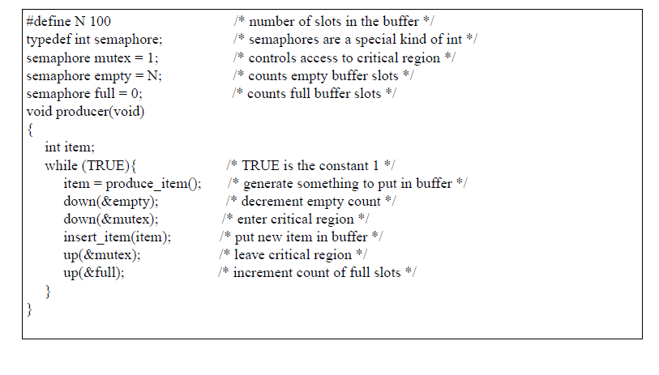
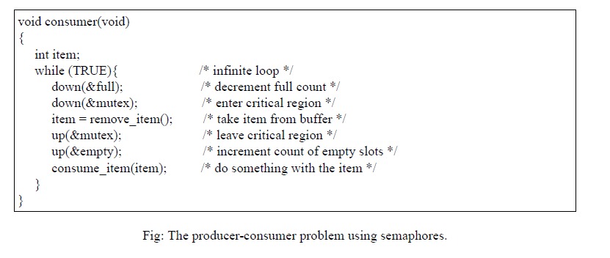
Operating Systems (2015R Regulation)

Slide 15
Operating Systems (2015R Regulation)
Implement the wait() & Signal() Semaphore operations in multiprocessor environment using the TestAnsSet() Instruction (Minimal busy waiting).
Pseudocode for implementing the operation:
int x = 0;
int semaphore value = 0;
wait()
{
while (TestAndSet (&x) == 1);
if (semaphore value == 0)
{
atomically add process to a queue of processes waiting for the semaphore and set x to 0;
}
else
{
semaphore value--;
x = 0;
}
}
signal()
{
while (TestAndSet (&x) == 1);
if (Semaphore value == 0 && there is a process on the wait queue)
wake up the first process in the queue of waiting processes
else
semaphore value++;
x = 0;
}

Slide 16
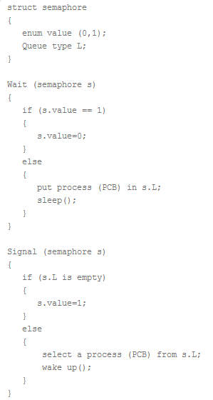
Operating Systems (2015R Regulation)
Two kinds of semaphores are:
1- Counting semaphore (Multiple resources)
2- Binary semaphores ( Only two states 0 – lock, 1- unlock)
Binary Semaphore has two components:
An integer value which can be either 0 or 1
An associated waiting list (usually a queue)
The waiting list of binary semaphore contains the processes that got blocked
when trying to enter the critical section.
In waiting list, the blocked processes are put to sleep.
The waiting list is usually implemented using a queue data structure.
Using a queue as waiting list ensures bounded waiting.
This is because the process which arrives first in the waiting queue gets the
chance to enter the critical section first.
The wait operation is executed when a process tries to enter
the critical section.
Then, there are two cases possible-
If the value of binary semaphore is 1,
The value of binary semaphore is set to 0.
The process is allowed to enter the critical section.
If the value of binary semaphore is 0,
The process is blocked and not allowed to enter the critical section.
The process is put to sleep in the waiting list.
The signal operation is executed when a process takes exit from
the critical section.

Slide 17
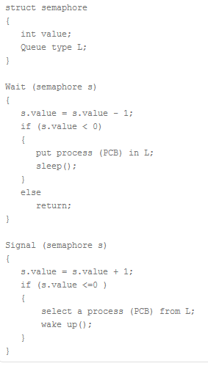
Operating Systems (2015R Regulation)
Counting semaphore (Multiple resources):
A counting semaphore has two components-
An integer value
An associated waiting list (usually a queue)
The value of counting semaphore may be positive or negative.
Positive value indicates the number of processes that can be present in the critical
section at the same time.
Negative value indicates the number of processes that are blocked in the waiting list.
The waiting list of counting semaphore contains the processes that got blocked
when trying to enter the critical section.
In waiting list, the blocked processes are put to sleep.
The waiting list is usually implemented using a queue data structure.
Using a queue as waiting list ensures bounded waiting.
This is because the process which arrives first in the waiting queue gets the chance
to enter the critical section first.
The wait operation is executed when a process tries to enter the critical section.
Wait operation decrements the value of counting semaphore by 1.

Slide 18
Operating Systems (2015R Regulation)
Then, following cases are possible-
Counting Semaphore Value >= 0
If the resulting value of counting semaphore is greater than or equal to 0, process is allowed to enter the critical section.
Counting Semaphore Value < 0
If the resulting value of counting semaphore is less than 0, process is not allowed to enter the critical section.
In this case, process is put to sleep in the waiting list.
The signal operation is executed when a process takes exit from the critical section.
Signal operation increments the value of counting semaphore by 1.
Counting Semaphore <= 0
If the resulting value of counting semaphore is less than or equal to 0, a process is chosen from the waiting list and wake up to execute.
Counting Semaphore > 0
If the resulting value of counting semaphore is greater than 0, no action is taken.
By adjusting the value of counting semaphore, the number of processes that can enter the critical section can be adjusted.
If the value of counting semaphore is initialized with N, then maximum N processes can be present in the critical section at any given time.
To implement mutual exclusion, the value of counting semaphore is initialized with 1.
It ensures that only one process can be present in the critical section at any given time.

Slide 19
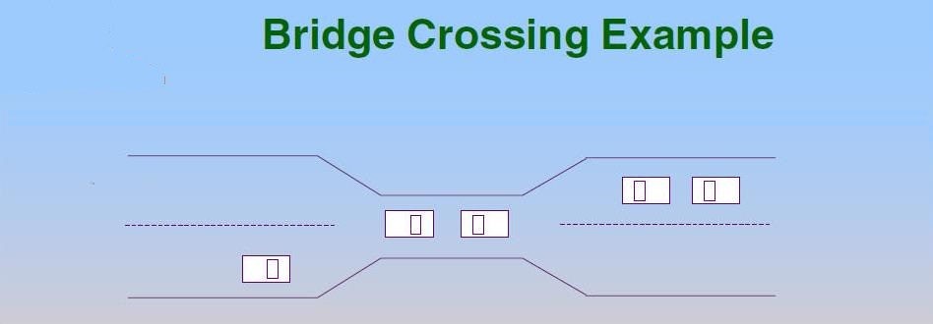
Operating Systems (2015R Regulation)
Deadlocks
System model
Deadlock characterization
Methods for handling deadlocks
Deadlock prevention
Deadlock avoidance
Deadlock detection
Recovery from deadlocks
DEADLOCKS:
A process requests resources;
If the resources are not available at that time, the process enters a waiting state.
Sometimes, a waiting process is never again able to change state, because the resources it has requested are held by other processes. This situation is called a deadlock.
→The resources may be partitioned into several types (or classes), each consisting of some number of identical instances.
If a process requests an instance of a resource type, the allocation of any instance of the type should satisfy the request.
If it does not, then the instances are not identical, and the resource type classes have not been defined properly.

Slide 20
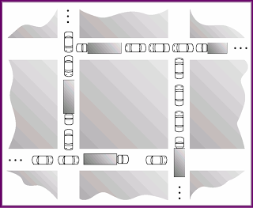
Operating Systems (2015R Regulation)

Slide 21
Operating Systems (2015R Regulation)
A process may utilize a resource in only the following sequence:
1. Request:
The process requests the resource.
If the request cannot be granted immediately (for example, if the resource is being used by another process), then the requesting process must wait until it can acquire the resource.
2. Use:
The process can operate on the resource (for example, if the resource is a printer, the process can print on the printer).
3. Release:
The process releases the resource.
→The request and release of resources may be system calls, as:
request(), release(), open(), close(), allocate() and free() system calls.
→The request and release of semaphores can be accomplished through the wait() and signal() operations on semaphores or through acquire() and release() of a mutex lock.

Slide 22
Operating Systems (2015R Regulation)
Two categories of resources:
1. Reusable resources: (Limited)
Process obtain resources, safely used later release for reuse by others.
Ex: Processors, I/O devices etc..
2.Consumable resources: (No Limit)
One that can be created and destroyed.
Ex: Interrupts, signals, messages etc..

Slide 23
Operating Systems (2015R Regulation)
Deadlock Characterization:
A deadlock situation can arise if the following four conditions hold resources simultaneously in a system:
1. Mutual exclusion:
Only one process at a time can use the resource.
If another process requests that resource, the requesting process must be delayed until the resource has been released.
2. Hold and wait:
A process must be holding at least one resource and waiting to acquire additional resources that are currently being held by other processes.
3. No preemption:
Resources cannot be preempted; that is, a resource can be released only voluntarily by the process holding it, after that process has completed its task.
4. Circular wait:
A set {P0, P1, ..., Pn} of waiting processes must exist such that P0 is waiting for a resource held by P1, P1 is waiting for a resource held by P2, ..., Pn−1 is waiting for a resource held by Pn, and Pn is waiting for a resource held by P0.

Slide 24
Operating Systems (2015R Regulation)
Methods for Handling Deadlocks :
Deal with the deadlock problem in following ways:
Use a protocol to prevent or avoid deadlocks, ensuring that the system will never enter a deadlocked state.
Allow the system to enter a deadlocked state, detect it, and recover.
1- Deadlock prevention:
Provides a set of methods to ensure that at least one of the necessary conditions cannot hold.
These methods prevent deadlocks by constraining how requests for resources can be made.
2- Deadlock avoidance :
Deadlock avoidance requires that the operating system be given additional information in advance concerning which resources a process will request and use during its lifetime.
All the pending processes can be successfully executed in some sequences and also satisfying their resource requirement completely. this sequences is called safe sequences and system in safe state.

Slide 25
Operating Systems (2015R Regulation)
3-Deadlock detection:
If a system does not employ either a deadlock-prevention or a deadlock avoidance algorithm, then a deadlock situation may occur.
In this environment, the system may provide:
An algorithm that examines the state of the system to determine whether a deadlock has occurred and to recover from the deadlock.
4-Deadlock Recovery:
Let the deadlock occur in the system and then try to recover the system from deadlock.
5- Allow deadlock to occur:
Let the deadlocks occur in the system DO NOTHING.
[ Sometimes operating system running anti deadlock algorithm called as FREEZE]

Slide 26
Operating Systems (2015R Regulation)
Deadlock prevention:
To prevent the system from deadlock one of the four condition should be discarded.
1- Mutual Exclusion:
We cannot prevent deadlock by denying mutual exclusion because, we do not have system with all resources being sharable (or) non sharable.
Example:
Read-only files are a good example of a sharable resource.
A process never needs to wait for a sharable resource.

Slide 27
Operating Systems (2015R Regulation)
2- Hold and Wait:
Objective:
Anyone of the process cannot hold resources.
Two ways of resource allocation:
1- Each process must request and get all of its resources before it being executed.
Demerits: All resources allocated but some resources are unused for long time.
2- Each process can request resources only when it does not hold any resources.
Demerits: This resource allocation is better but may be the chance of starvation.
3- No Preemption:
If process is holding some resources and request another resources that cannot be allocated to it.
Operating system check other resources are used (or) unused by another process, if it is unused means the operating system preempts resources and requested process restarted again old as well as new request resources.
4- Circular wait:
Each process can only request resources in an increasing order of priority and it must have release all resources.

Slide 28
Operating Systems (2015R Regulation)
Deadlock Avoidance:
Deadlock avoidance requires that the operating system be given additional information in advance concerning which resources a process will request and use during its lifetime.
→ Every process in advance declare what is maximum requirement of the process.
→ The system must able to decide whether granting a resource is safe (or) not and will only make the allocation when it is safe.
Deadlock Avoidance
[RAG Algorithm] [Banker’s Algorithm]

Slide 29
Operating Systems (2015R Regulation)
Resource-Allocation Graph:
Deadlocks can be described more precisely in terms of a directed graph called a system resource-allocation graph.
This graph consists:
1.set of vertices V
2.set of edges E
The set of vertices V is partitioned into two different types of nodes:
P = {P1, P2, ..., Pn}, the set consisting of all the active processes in the system.
R = {R1, R2, ..., Rm}, the set consisting of all resource types in the system.
A direct edge from process to resources type is denoted by:
Pi → Rj is called as Requested edge.
Rj → Pi is called as assignment edge.
In a graph:
Process representing as circle.
Resources representing as square.
Dot within the square represents the number of instances.

Slide 30
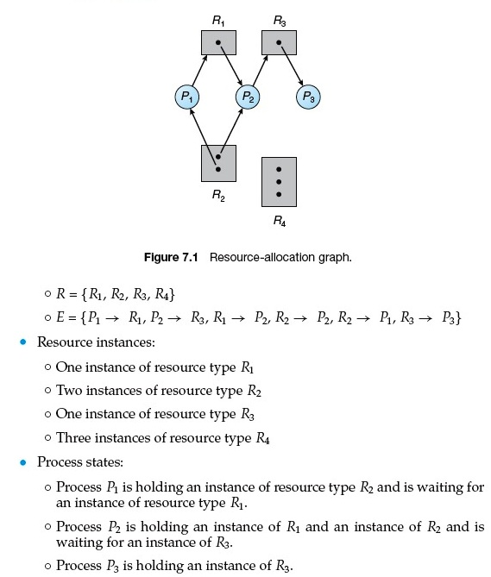
Operating Systems (2015R Regulation)
Resource allocation graph:

Slide 31
Operating Systems (2015R Regulation)
Banker’s Algorithm:
When a new process enters the system, it declares the maximum number of instances that are needed.
This number cannot exceed the total number of resources in the system.
If the process can be accommodated based upon the needs of the system, then resources are allocated, otherwise the process must wait.
The algorithm is actually made up of two separate algorithms:
Safety algorithm and Resource request algorithm.
Before P_{i} starts executing, it must declare the maximum number of instances of each resource type that it may need.

Slide 32
Operating Systems (2015R Regulation)
Data structures for the banker’s algorithm
Let,
Vector of length n = number of processes
Vector of length m = number of resource types.
Step 1:
Available : Vector of length m
Available [ j ] = k
[k is number of instances of the resource type R_{j} ]
Step 2:
Max : n x m matrix
Max [ i , j ] = k
[Process P_{i} request at maximum number of k instances of resource type R_{j} for its completion]
Step 3:
Allocation : n x m matrix
Allocation [ i , j ] = k
[ k number of instances of resource type R_{j} is currently allocated to process p_{i} ]
Step 4:
Need : n x m matrix
Need [ i , j ] = k
[ k number of instances of resource type R_{j} will be required by process P_{i} to complete its job]
Need [ i , j ] = Max [ i , j ] – Allocation [ i , j ]

Slide 33
Operating Systems (2015R Regulation)
Safety algorithm
The safety algorithm is used to determine if a system is in a safe state
Let,
Work : vectors of length m
Finish: vectors of length n
Step 1:
Work =Available;
Finish [ i ] = false;
for all i=0,1,2,……..n;
Step 2:
Find i such that
Finish [ i ] == false;
Need [ i ] <= work;
If no such i exists then the system is in unsafe state; return; go to step 4.
Step 3:
Work = Work + Allocation [ i ] ;
Finish [ i ] =true;
go to step 2.
Step 4:
Finish [ i ] == true for all i
the system is in a safe state;
This algorithm may require an order of m × n² operations to determine whether a state is safe.

Slide 34
Operating Systems (2015R Regulation)
Resource Request algorithm for process P_{i}
The resource-request algorithm is used to determine whether requests can be safely granted.
Let,
Request_{i} = Request vector for process P_{i}.
If Request_{i} [ j ] ==k ;
Then process P_{i} wants k instance of resource type R_{j}.
If Requesti <= Needi, go to step 2. Otherwise, raise an error condition, since the process has exceeded its maximum claim.
If Requesti <= Available, go to step 3. Otherwise, Pi must wait, since the resources are not available.
Pretend to have allocated the requested resources to process P_{i} by modifying the state as follows:
Available = Available–Request_{i} ;
Allocationi = Allocation_{i} + Request_{i} ;
Need_{i} = Need_{i} –Request_{i} ;
If safe → resource are allocated to P_{i}
If unsafe → P_{i} must wait

Slide 35
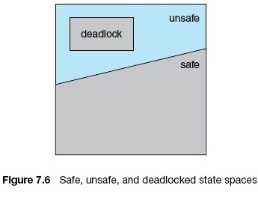
Operating Systems (2015R Regulation)
Safe state:
All the pending processes can be successfully executed in some sequences and also satisfying their resource requirement completely.
This sequences is called safe sequences and system in safe state.

Slide 36
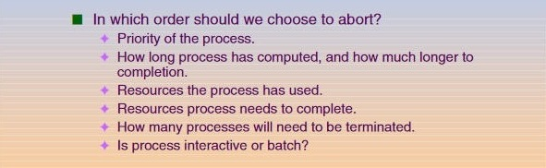
Operating Systems (2015R Regulation)
Deadlock Recovery:
The system recover from the deadlock automatically.
There are two options for breaking a deadlock:
Deadlock Recovery
[Process Termination] [Resource Preemption]
Process Termination:
To eliminate deadlocks by aborting a process.
Two methods:
Abort all deadlocked processes.
Abort one process at a time until the deadlock cycle is eliminated.

Slide 37
Operating Systems (2015R Regulation)
Resource Preemption:
To eliminate deadlocks using resource preemption , We successively preempt some resources from processes and give these resources to other processes until the deadlock cycle is broken.
Three issues need to be addressed:
Select a Victim
Which resources and which processes are to be preempted?, We must determine the order of preemption to minimize cost.
Rollback
We must roll back the process to some safe state and restart it from that state.
(Difficult → Abort the process and then restart it)
Starvation
Same process may always be picked as victim, Include number of rollback in cost factor. ( Ensure that a process can be picked as a victim only a (Small) finite number of times)

